Slide 1
Achieving Self-organizing Maps
on clustering analysis of temporal characteristics of car crashes
The A-Team
Notes:
‹#›

Slide 2
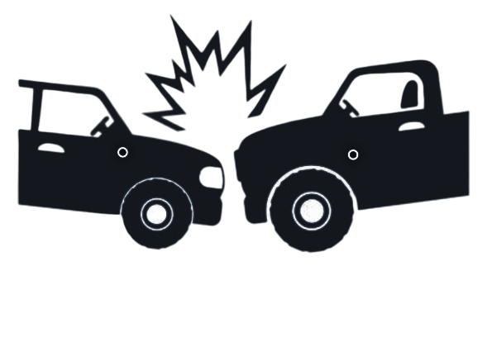
Abstract
Vehicle crashes happen every minute in the United States, each crash having its own time and specific attributes such as road conditions and weather. The goal of this project is to find meaningful spatial and temporal patterns from the large datasets provided by state DOT’s. Using a self-organizing map, data can be classified into meaningful clusters based on time of year, month, or day in a way that is easy to read. This allows for a more in-depth analysis. Data can then be joined to point data in ArcMap to show how patterns relate spatially within certain attributes like road conditions, number of injuries or weather conditions. The significance of this is that it allows temporal data to be joined to spatial data. This allows for multifaceted in-depth analysis.

Slide 3
Introduction
Current knowledge gap in crash analysis: Geospatial methods aren’t as accurate, and don’t consider temporal aspects, and can’t be used to predict future collisions.
Incorporating temporal aspects to detecting road collision risk is the goal of this project.
Using Python to develop Self-Organizing Temporal maps for analyzing road safety

Slide 4
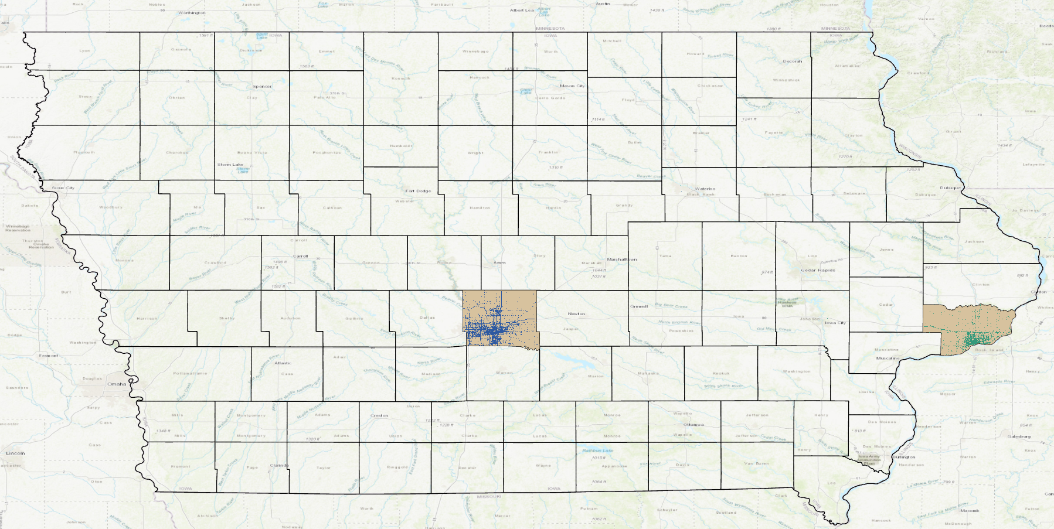
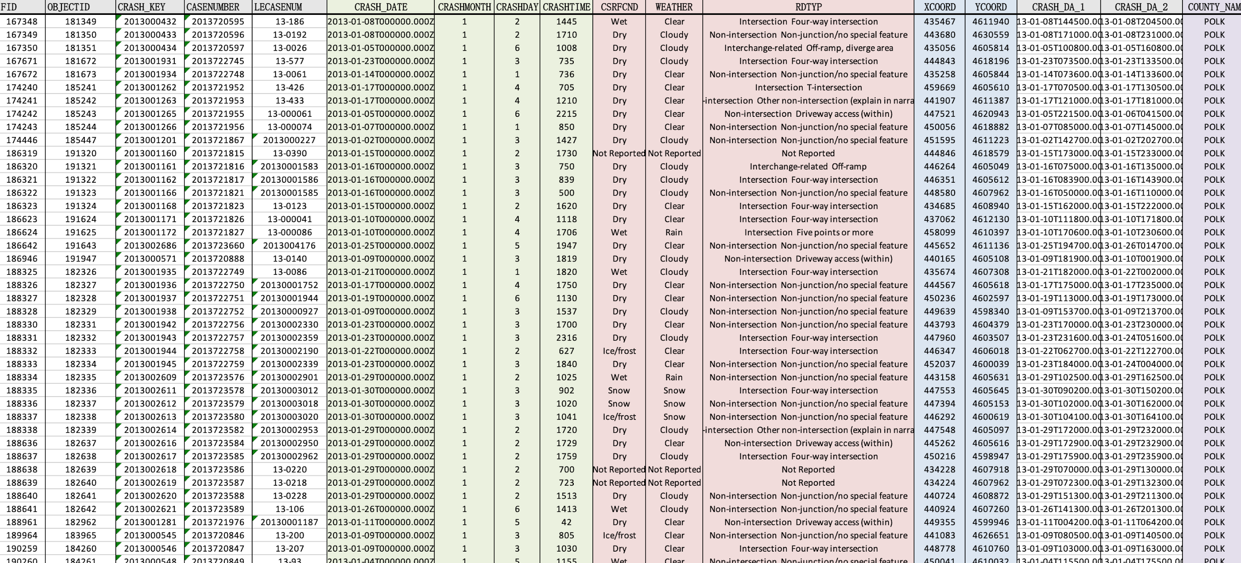
Data
Polk County
(No.1 ranked in population)
Scott County
(No.3 ranked in population)

Slide 5
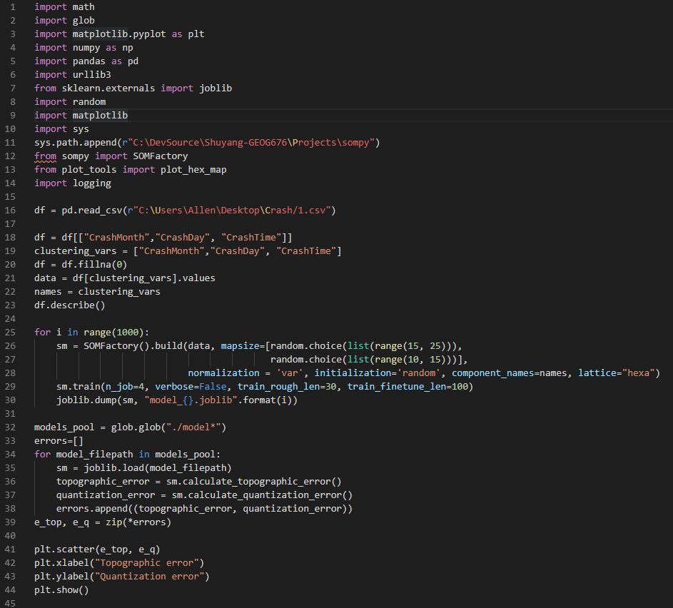
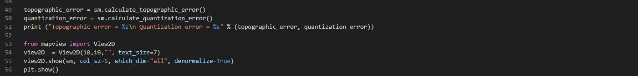
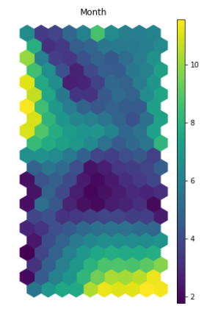
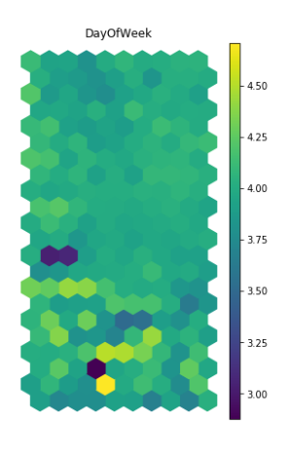
Methods

Slide 6
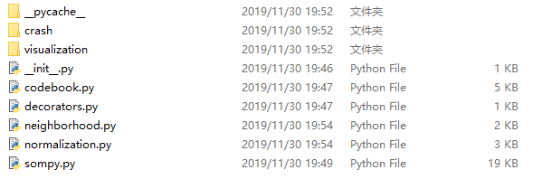
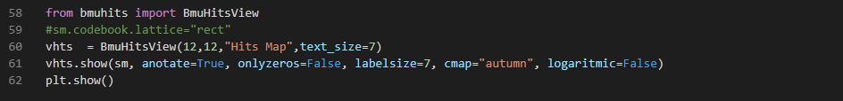
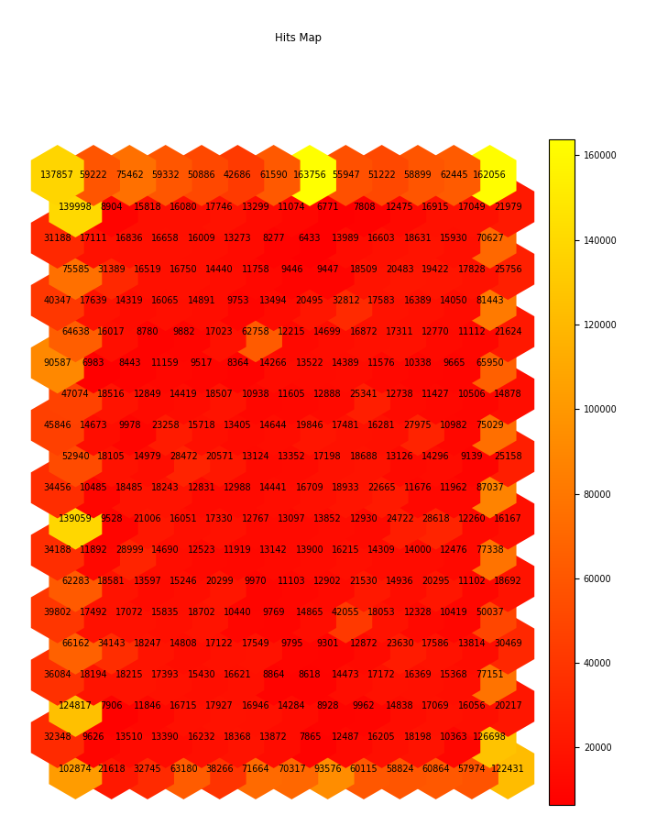
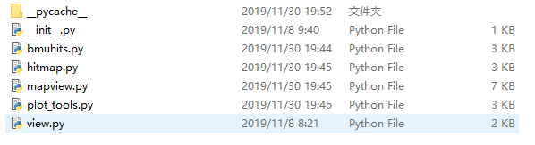
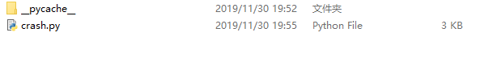
Methods

Slide 7
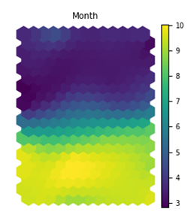
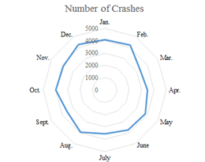
Results
Temporal Analysis-monthly
(a) (b) (c)
(a)Clustering result of car crashes monthly distribution in Polk County (2013);
(b)Hits map for clustered data in Polk County;
(c)Total car crashes data monthly distribution in Polk County (2011-2016)

Slide 8
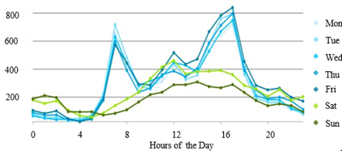
Results
Temporal Analysis-daily
(a) (b) (c)
(a)Clustering result of car crashes daily distribution in Polk County (2013);
(b)Hits map for clustered data in Polk County
(c)Total car crashes data daily and hourly distribution in Polk County (2011-2016)

Slide 9
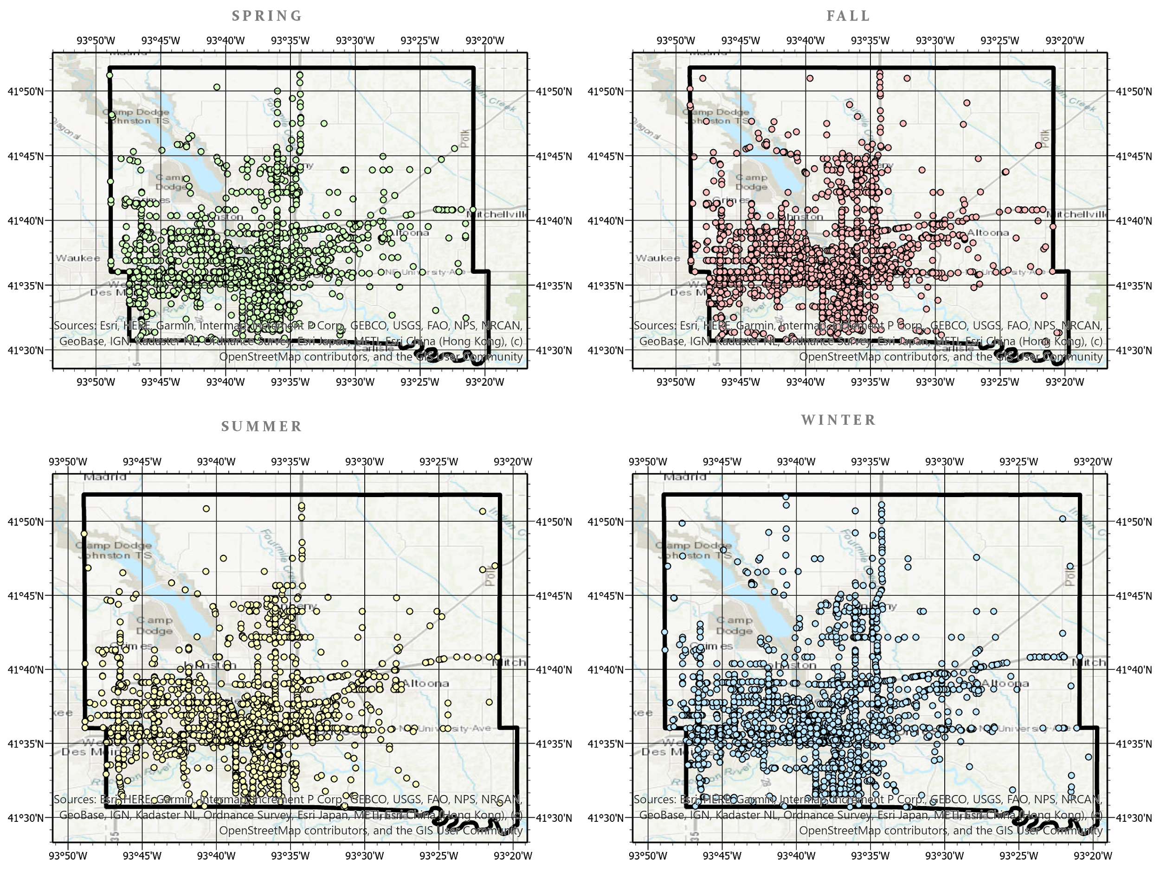
Results
Spatial distribution
Polk County by Season

Slide 10
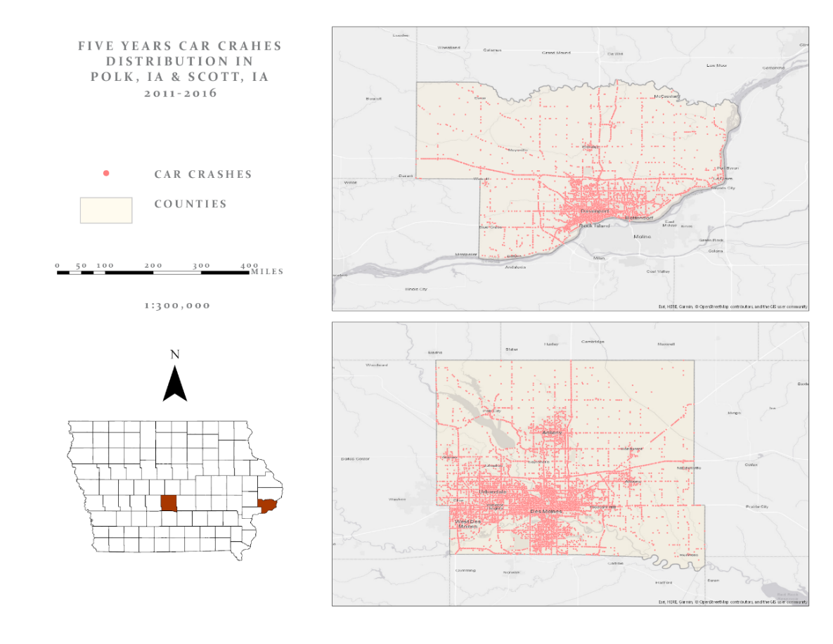
Results
Spatial distribution
Car crashes distribution in Polk County and Scott County, IA (2011-2016).

Slide 11
Conclusion
winter months have higher crash occurrences, which may be caused by poor weather conditions and fewer daylight hours.
weekdays have more car collisions than weekends. And 7 am, 4 pm, and 5 pm are the top 3 high-risk hours for driving due to high traffic volume.
Polk and Scott have similar temporal traffic patterns but different spatial patterns.

Slide 12
Future work
High level analysis technologies are required to make sense of complex data
Self-organizing map can representants effectvily spatiotemporal pattern
This methodology can be used to map other phenomena

Slide 13
Questions?

Slide 14
Thank You!

